Slide 1

Balanced scorecard slide 1
Project 4
Math512
Qinying He, Ruxin Jin, Zhiyang Wei

Slide 2
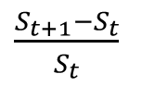
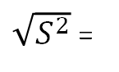
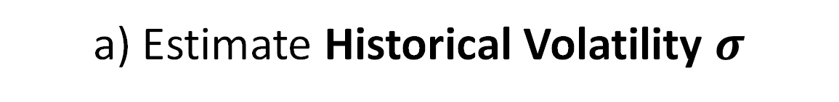
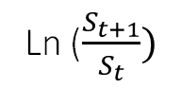
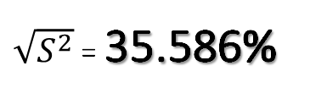
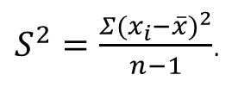
a) Estimate Historical Volatility $σ$
CALCULATE RETURN
$\frac{S_{t+1}−S_{t}}{S_{t}}$
$S^{2}=\frac{Σ{(x_{i}−\overline{x})}^{2}}{n−1}$.
VALUE OF STANDARD DEVIATION
VOLATILITY
$\sqrt{S^{2}}$ = 35.586%
CALCULATE LOG RETURN
Ln ($\frac{S_{t+1}}{S_{t}})$
HISTORICAL VOLATILITY
$\sqrt{S^{2}}$ =
35.5889%

Slide 3
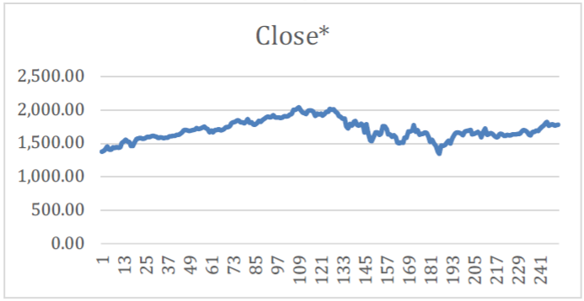
AMAN Closing Prices

Slide 4
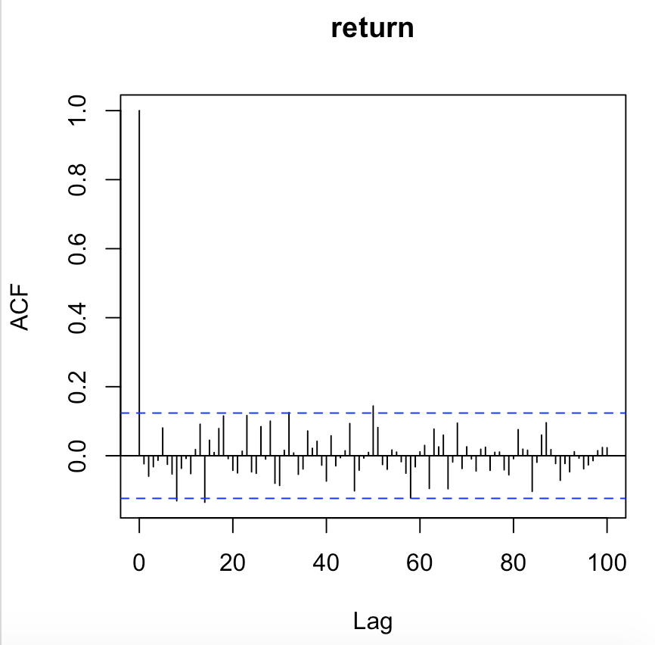
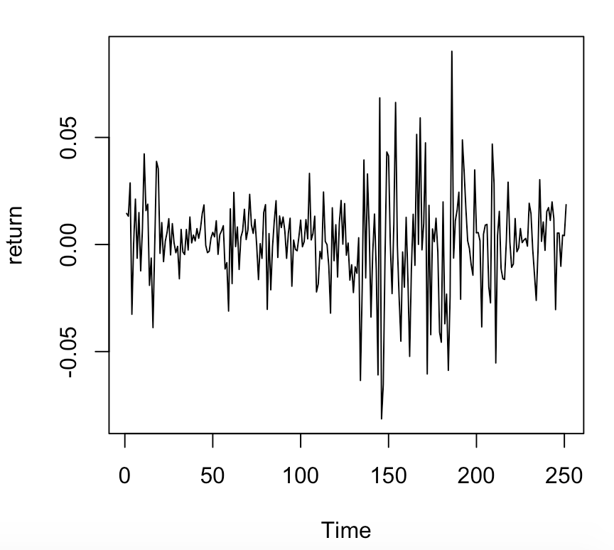
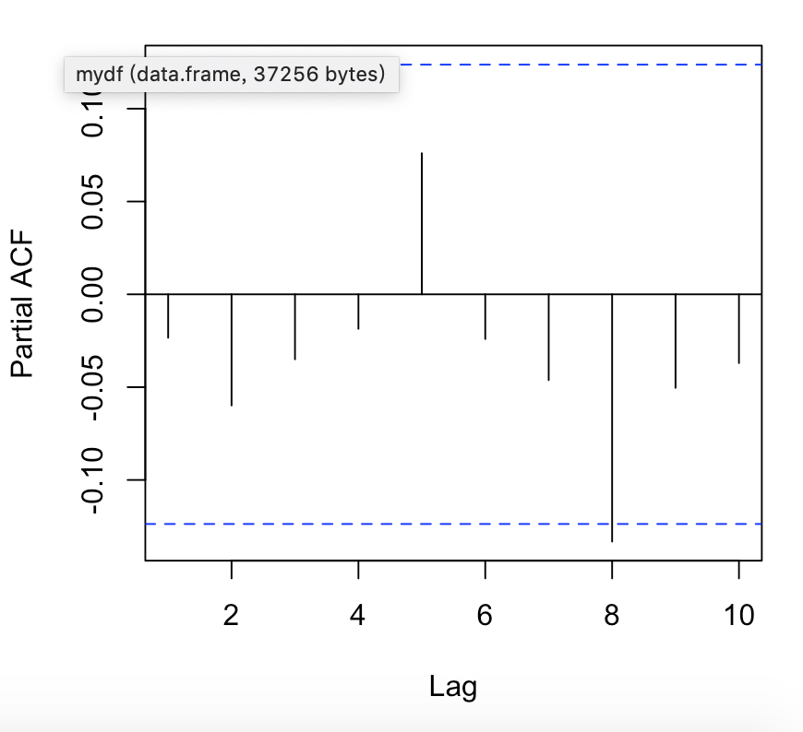
Time Series Analysis
Log-return plot
Looks like WN
ADF test p-value: 0.01
--> stationary

Slide 5
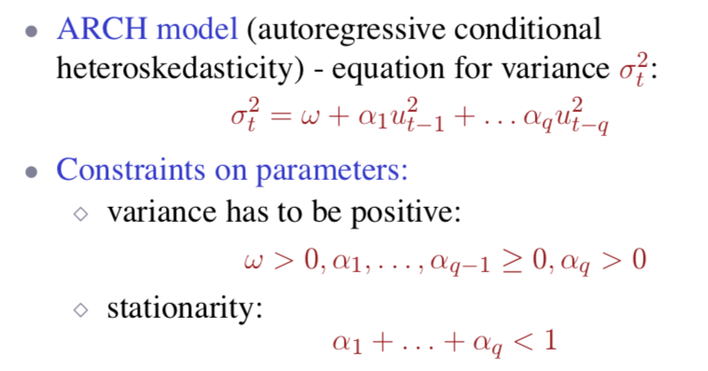
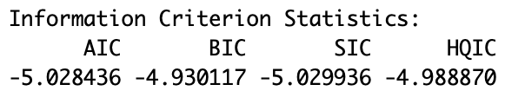
ARCH and GARCH Model
We tried ARCH(1), ARCH(2), ARCH(3) and ARCH(4), but the residuals are not white noise;
AIC and BIC test:
we got ARCH(5)

Slide 6
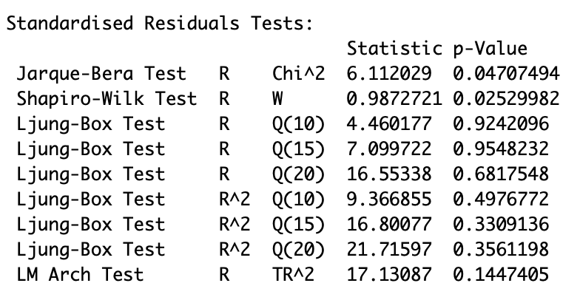
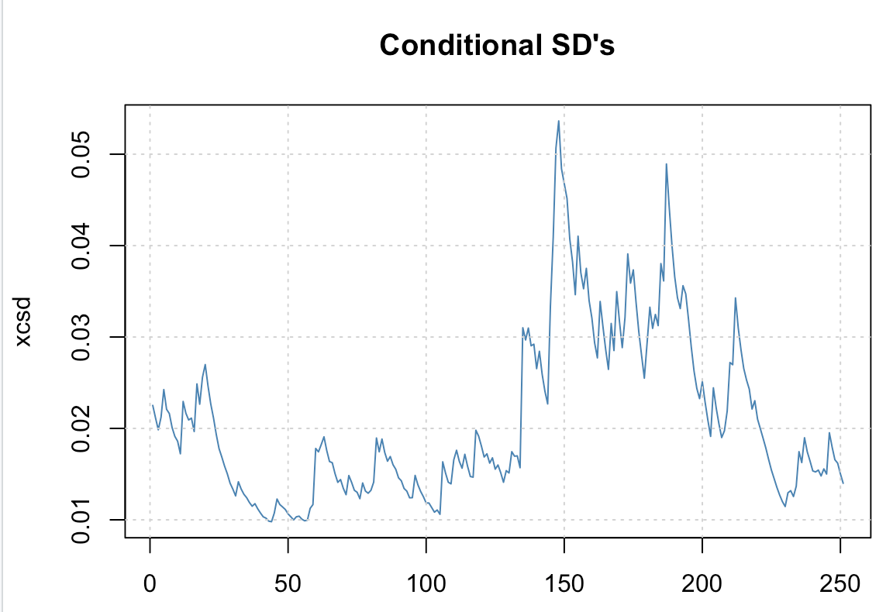
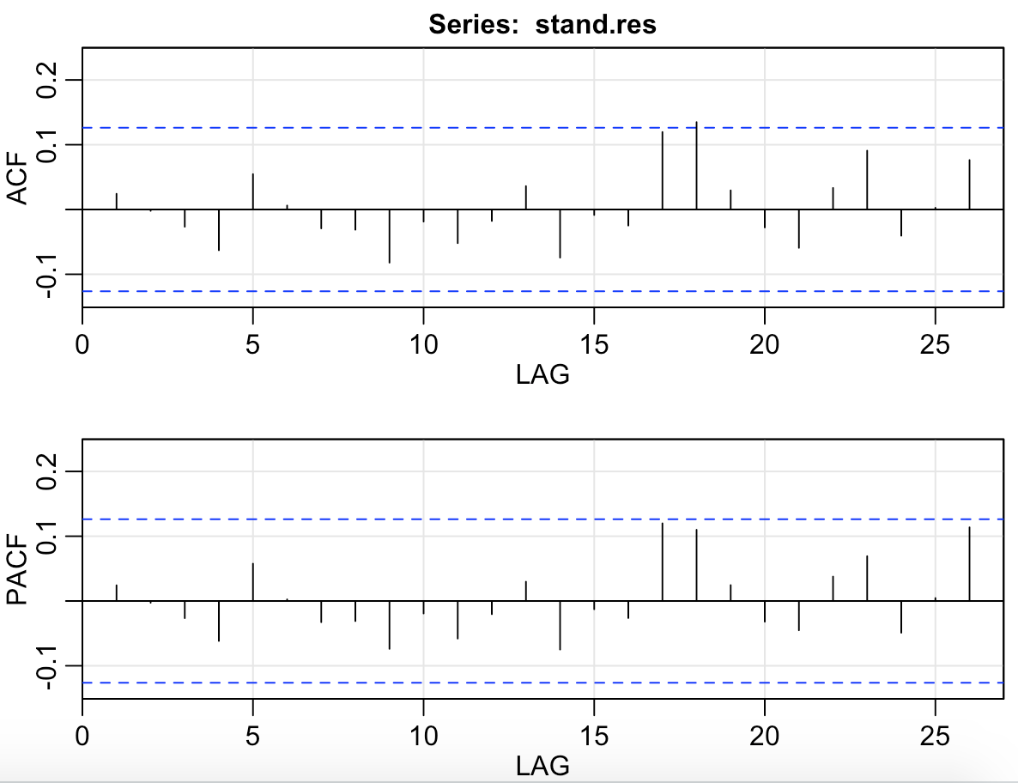
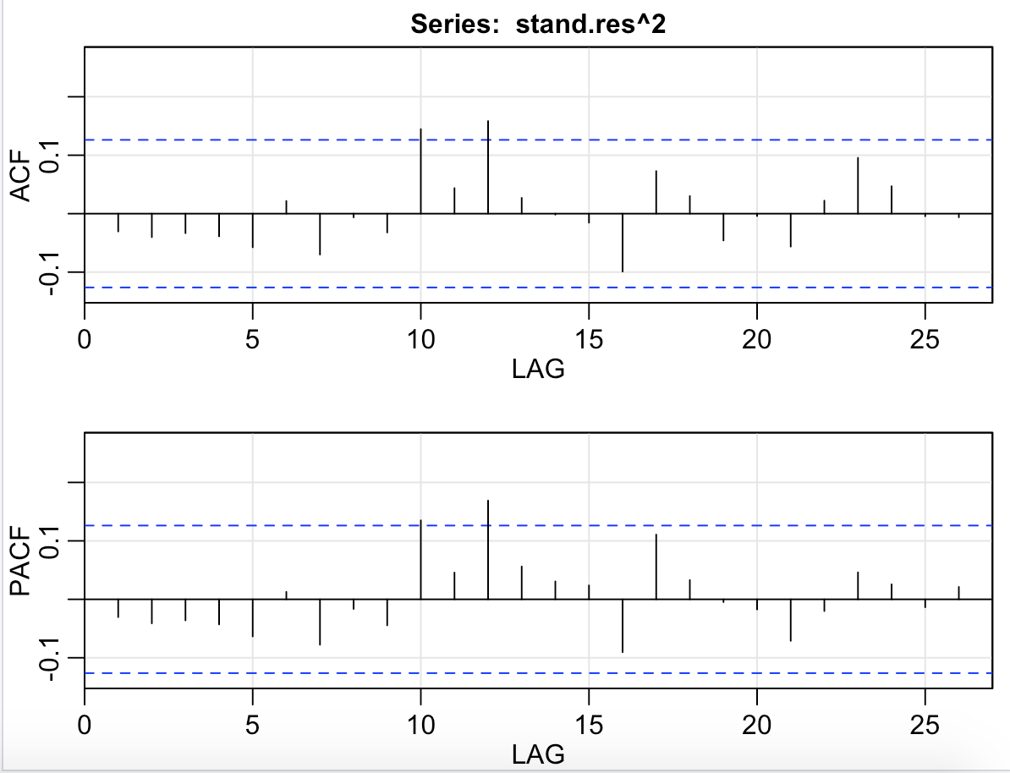
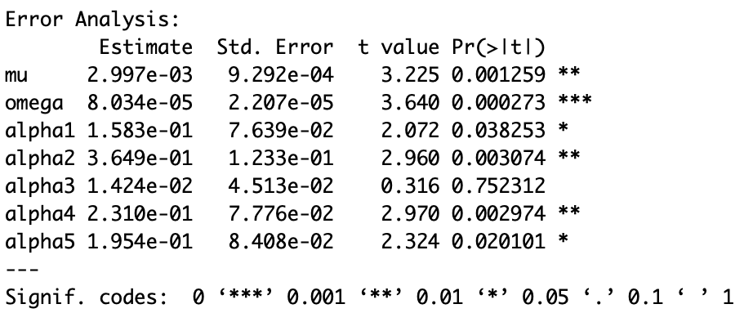
ARCH(5) Model
Implied volatility forecast:
0.03056744

Slide 7
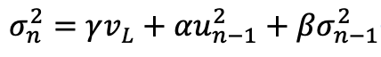
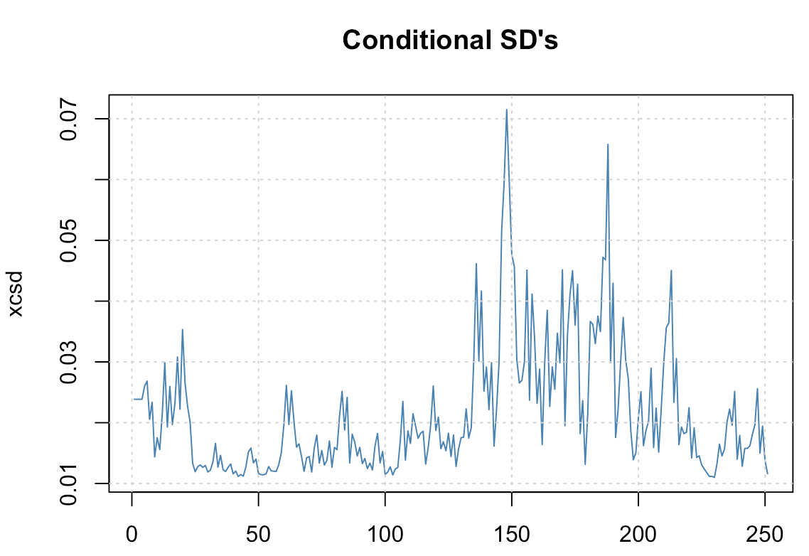
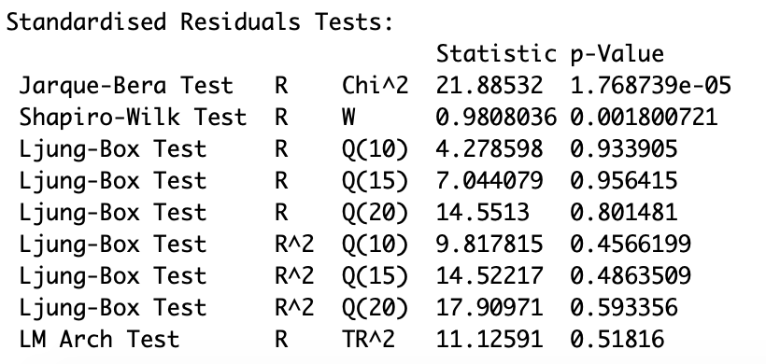
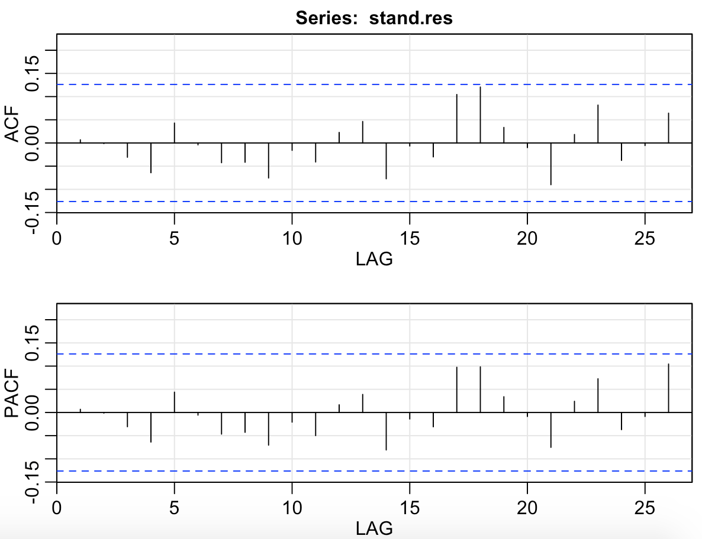
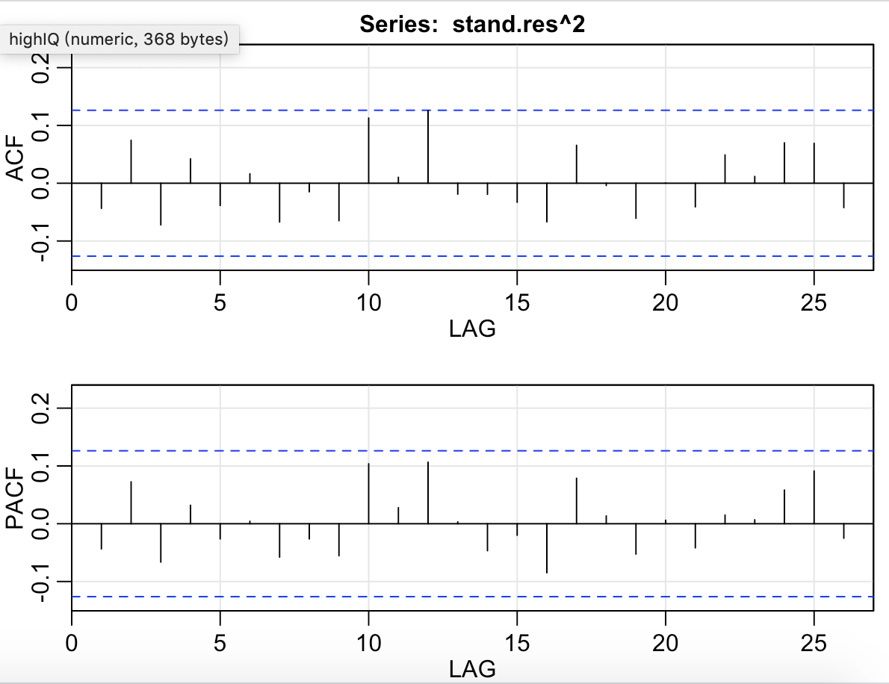
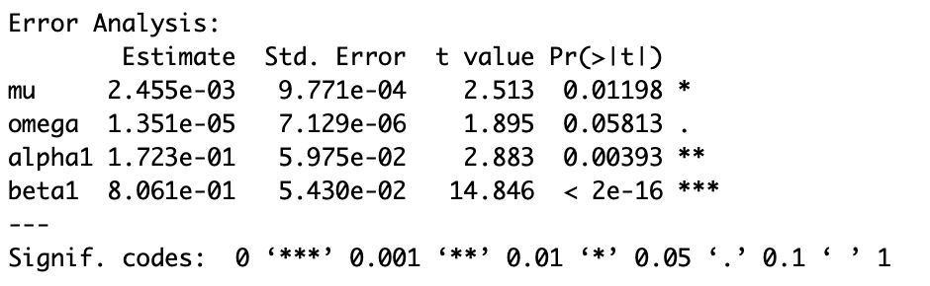
GRCH(1,1) Model
Implied volatility forecast:
0.03452849

Slide 8
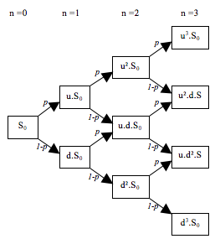
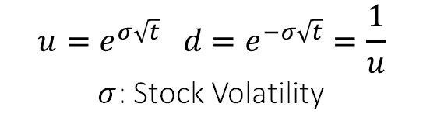
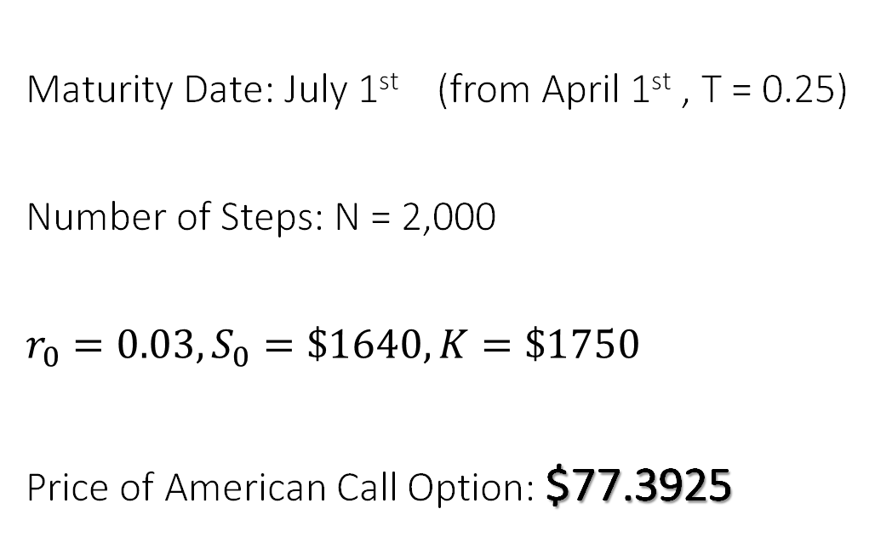
b) American Call Option Price - Binomial Tree Approach
Maturity Date: July 1st (from April 1st , T = 0.25)
Number of Steps: N = 2,000
$$r_{0}=0.03, S_{0}=\$1640, K=\$1750$$
Price of American Call Option: $77.3925
$$u=e^{σ\sqrt{t}} d=e^{−σ\sqrt{t}}=\frac{1}{u}$$
$σ$: Stock Volatility

Slide 9
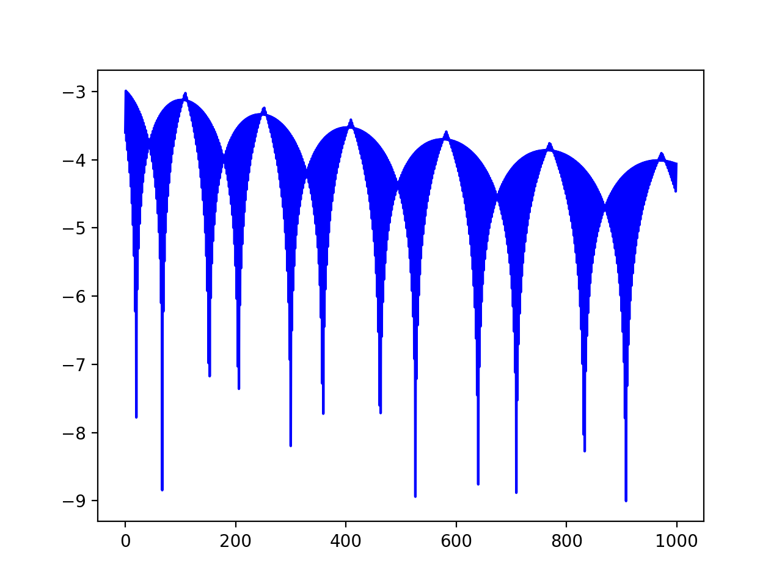
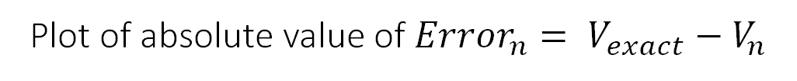
Sawtooth Pattern
Plot of absolute value of ${Error}_{n}= V_{exact}−V_{n}$

Slide 10

Balanced scorecard slide 4
c) Convergence Rate of Binomial Tree Approach
Binomial Model provide a discrete time approximation to the continuous process underlying the Black-Scholes model
The Binomial model value converges on the Black-Scholes formula value as the number of steps increases.
Plot Error against n, the graph has a clear sawtooth pattern and periodic humps
The rate of convergence of Binomial Tree approach is 1 (linear convergence).

Slide 11
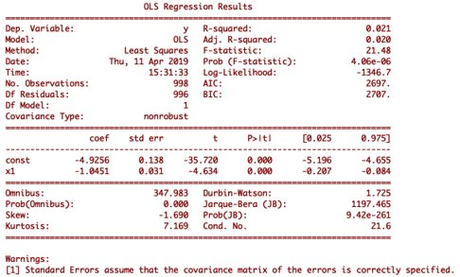
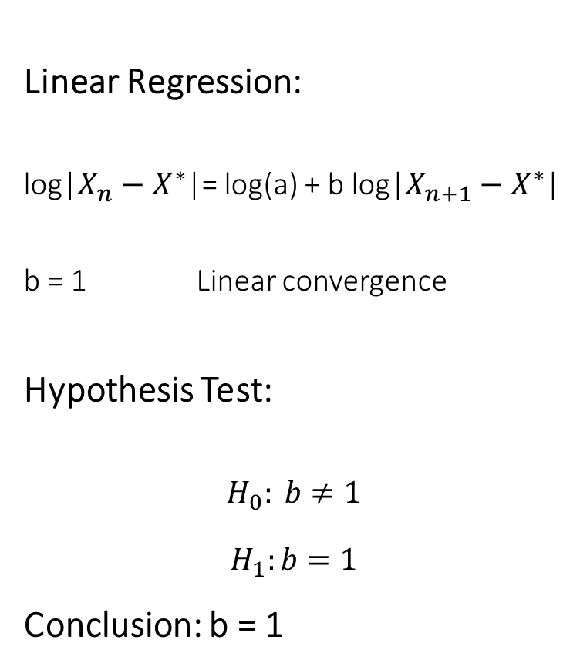
Linear Regression:
log|$X_{n}−X^{∗}$|= log(a) + b log|$X_{n+1}−X^{∗}$|
b = 1 Linear convergence
Hypothesis Test:
$$H_{0}: b≠1$$
$$H_{1}:b=1$$
Conclusion: b = 1

Slide 12

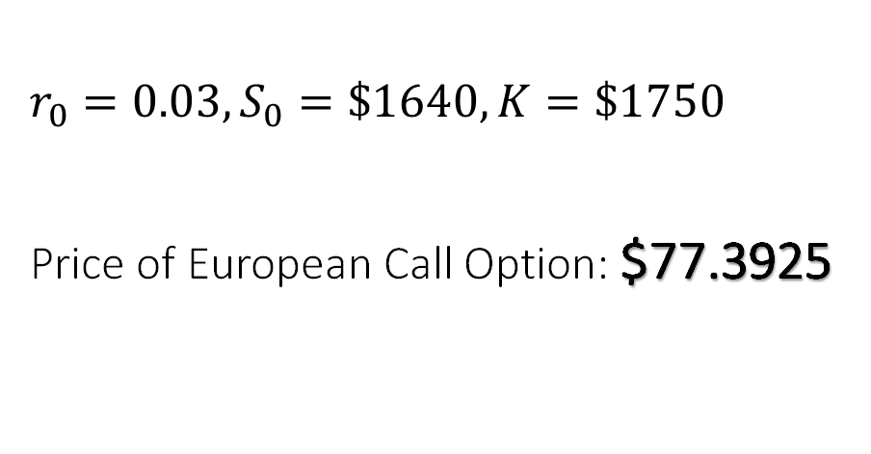
d) European Call Option Price - Binomial Tree Approach
$$r_{0}=0.03, S_{0}=\$1640, K=\$1750$$
Price of European Call Option: $77.3925
SAME as part b)!
Reasoning: The option has no dividend, so the buyers of this American call option will not exercise until the maturity date.

Slide 13
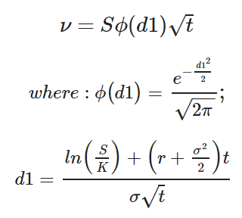
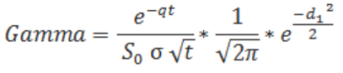
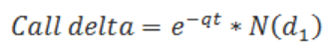
European Call Option Price | $77.4034
Corresponding Put Option Price | $174.3275
e)
Vega
Delta
Gamma
334.23612
0.40761
0.0013987
Impact of a change in volatility
Impact of a change in stock price
Impact of a change of Delta

Slide 14

f) European Call Option Price
– Simple Monte Carlo Method
Method | European Call Option Price
Simple Monte Carlo | $77.9116
Black-Scholes | $77.4034
Binomial Tree | $77.3925
When N = 1500, the value derived from the Binomial Tree method is more accurate than the one derived from the Simple Monte Carlo method

Slide 15
g) European Call Option Price
– Monte Carlo with Antithetic Variates
European Call Option price: $77.9056
Standard deviation: 158.875
h) European Call Option Price
– Monte Carlo with Control Variates
European Call Option price: $77.8381
Standard deviation: 108.117
Notes:
For part g and h, we use the same approaches as we did on the last two projects to calculate the price of European option
And for Monte Carlo with Antithetic variates, the option price is $77.9056 and for Monte Carlo with Control Variates, the option price is $77.8381

Slide 16
h)
Method | European Call Option Price | Standard Deviation
Simple Monte Carlo | $77.9116 | 161.326
Antithetic Variates | $77.9056 | 158.875
Control Variates | $77.8381 | 135.117
Pricewise, no big discrepancy
Variance: Simple Monte Carlo > Control Variates > Antithetic Variates
Notes:
On this table we can see that in general all the methods give us similar option prices but the Antithetic variates method and the control variates method help us to reduce the variance.

Slide 17
h) Convergence of Monte Carlo Method
Method | # of time steps =10, paths=1000 | 100 | 1000 | 10,000
Simple Monte Carlo | $87.80 (abs err = 9.8884) Sd = 176.88 | 76.77 (1.1416) 158.40 | 79.25 (1.3384) 165.49 | 77.37 (0.5416) 165.326
Antithetic Variates | $77.53 (0.3816) Sd = 162.8674 | 73.9655 (3.9461) 155.798 | 78.23 (0.3184) 160.77 | 77.91 (0.0016) 156.875
Control Variates | $72.92 (4.9916) Sd = 148.35 | 74.47 (3.4416) 149.36 | 77.43 (0.4816) 144.85 | 77.25 (0.6616) 143.117
Method | # of time paths =10, steps=1000 | 100 | 1000 | 10,000
Simple Monte Carlo | $6.54 (71.3716 Sd = 19.63 | 94.37 (16.4584) 187.83 | 78.51 (0.5984) 160.05 | 77.92 (0.0084) 161.326
Antithetic Variates | $114.83 (36.9184) Sd = 178.21 | 80.01 (2.0984) 158.04 | 77.32 (0.5916) 158.30 | 77.82 (0.0916) 158.875
Control Variates | $170.62 (92.7084) Sd = 213.6 | 98.13 (20.2104) 175.32 | 77.51 (0.4016) 131.08 | 77.97 (0.0584) 128.117
Notes:
And this table here gives us a closer look of the performance of those three methods. As we can see here all the methods give different option prices, absolute errors, and standard deviation. As we increase the number of the steps, the corresponding absolute error is getting smaller which means the option price derived from each method converges to the correct price. Moreover, we can see the decrease in the standard deviation as we increase the number of the steps.

Slide 18

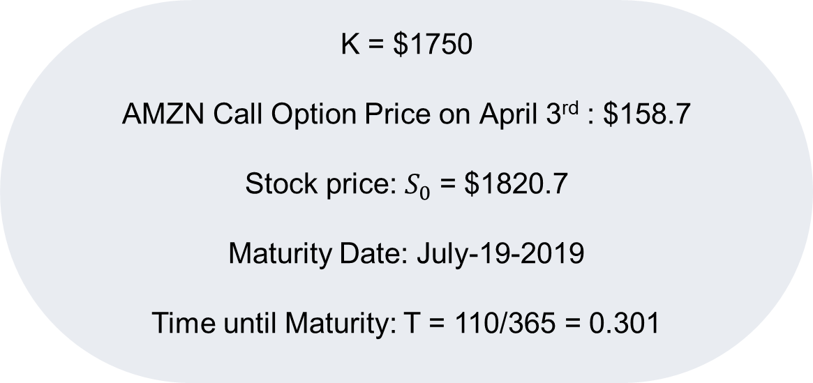
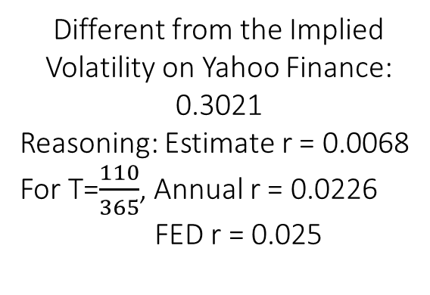
i) Estimate Implied Volatility
K = $1750
AMZN Call Option Price on April 3rd : $158.7
Stock price: $S_{0}$ = $1820.7
Maturity Date: July-19-2019
Time until Maturity: T = 110/365 = 0.301
Different from the Implied Volatility on Yahoo Finance: 0.3021
Reasoning: Estimate r = 0.0068
For T=$\frac{110}{365}$, Annual r = 0.0226
FED r = 0.025
Backward Solving B-S Formula
Implied Volatility = 0.2832146
Notes:
For estimate the implied volatility, we get the following data here from Yahoo Finance, and then plug those numbers in to the Black-Scholes model, and back solve the equation to get the implied volatility which is around 0.2832.
However, based on Yahoo Finance, the implied volatility should be around 0.3021 which is different from the one we got. The difference is because we use different r here. If we use the similar backward solving method, we can get that our estimated r which is 0.0068 and then the annual r should be about 0.0226 which is different from the r setting by the Federal reserve.

Slide 19

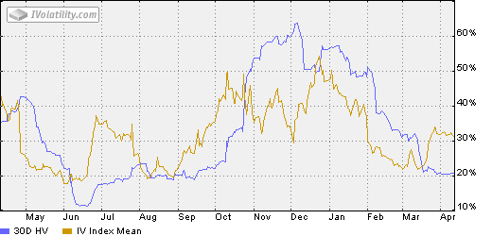
Balanced scorecard slide 4
I) Historical Volatility (HV) vs. Implied Volatility (IV)
HV: annualized standard deviation of past stock price movement
HV
IV
IV: derived from an option’s price and shows what the market implies about the stock’s volatility in the future
Notes:
Theoretically, historical volatility is annualized standard deviation of past stick price movement and implied volatility is derived from an option’s price and shows what the market implied about the stock’s volatility in the future, so they have different roles when we make trading strategies. And in this graph, we put Amazon’s one year historical volatility and implied volatility together and we can clearly see the different movement of those two volatilities.

Slide 20
Balanced scorecard slide 10
THANK YOU

